Slide 2
A BIG SALUTE to all
Nursing fraternity
COVID warriors

Slide 4
Challenging Role of Nurses: COVID 19 Second Wave Pandemic
Rebecca K
Senior Nursing Officer
Hospital Infection Control Committee
NIMHANS, BENGALURU

Slide 5
OUTLINE:
Facts about corona virus outbreak
Difference between 1st and 2nd wave of COVID 19
Nurses Role in COVID Management – Hospital / Community / Home

Slide 6
Scenario: COVID 19 Outbreak
Globally, as of 2:41pm CEST, 30 April 2021,
150,110,310 confirmed cases of COVID-19, including 3,158,792 deaths, reported to WHO.
As of 28 April 2021, a total of 1,011,457,859 vaccine doses have been administered.
Source: WHO Coronavirus dashboard

Slide 7
Scenario: COVID 19 Outbreak
In India, from 3 January 2020 to 2:41pm CEST, 30 April 2021,
18,762,976 confirmed cases of COVID-19 with 208,330 deaths, reported to WHO.
As of 26 April 2021, a total of 147,727,054 vaccine doses have been administered.
Source: WHO Coronavirus dashboard

Slide 8
FACTS ABOUT COVID 19

Slide 9
FACT: The coronavirus disease (COVID-19) is caused by a virus, NOT by bacteria

Slide 10
FACT: Vitamin and mineral supplements cannot cure COVID-19

Slide 11
FACT: The likelihood of shoes spreading COVID-19 is very low

Slide 12
FACT: The prolonged use of medical masks * when properly worn, DOES NOT cause CO2 intoxication nor oxygen deficiency

Slide 13
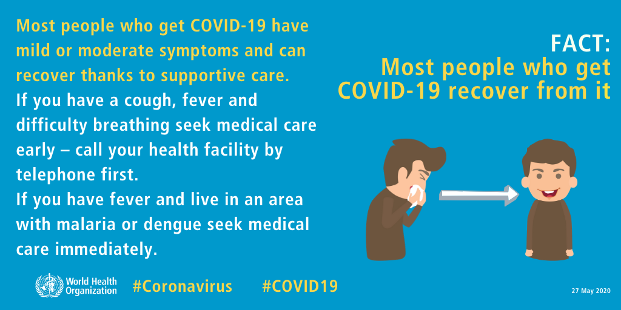
FACT: Most people who get COVID-19 recover from it

Slide 14
FACT: Drinking alcohol does not protect you against COVID-19 and can be dangerous

Slide 15
FACT: Thermal scanners CANNOT detect COVID-19

Slide 16
FACT: Adding pepper to your soup or other meals DOES NOT prevent or cure COVID-19

Slide 17
FACT: Taking a hot bath does not prevent COVID-19

Slide 18
FACT: Hand dryers are NOT effective in killing the COVID-19 virus

Slide 19
FACT: Ultra-violet (UV) lamps should NOT be used to disinfect hands or other areas of your skin

Slide 20
FACT: Vaccines against pneumonia DO NOT protect against the COVID-19 virus

Slide 21
FACT: Rinsing your nose with saline does NOT prevent COVID-19

Slide 22
FACT: Eating garlic does NOT prevent COVID-19

Slide 23
FACT: Antibiotics CANNOT prevent or treat COVID-19

Slide 24
FACT: People of all ages can be infected by the COVID-19 virus

Slide 25
Difference between first and second wave

Slide 26
Surfing the COVID 19 wave in India
Sudden outbreak emerged as pandemic
Very new and evolving
Non Pharmaceutical Intervention as mitigation measures
At least 5 nation-wide lockdowns (in India)
More awareness and knowledge(MoHFW /CDC/WHO)
Lockdown (in different stages) in few states.
Night curfew, weakened lockdown
First wave
Second wave

Slide 27
Strategy:
Case finding, contact tracing, containment, testing
Affected the adult population mostly
Symptoms – Fever, cough, loss of taste and smell
Upsurge of cases
Affects all age groups
Add on Symptoms
Conjunctivitis, Diarrhea, rashes, headache, body ache
First wave
Second wave

Slide 28
Surfing the COVID 19 wave in India
Manpower and resources shortage
Effective RT was 3.75 highest 2020
Number of people infected from infected persons
Acute shortage of oxygen , beds
Year later, it was 1.65
(Multiple super spreader events and poor compliance) rose sharply
More infectious and higher community spread.
More cases in children and infants
Mild to moderate symptoms in many (possibly because of vaccine)
First wave
Second wave

Slide 29
Surfing the COVID 19 wave in India
High stigma and discrimination
No vaccines
Less stigma and discrimination against HCW
Vaccination not covered
Newer variants
First wave
Second wave

Slide 30
SARS - CoV -2 Variants of concern
There are currently five VOCs in the United States:
B.1.1.7: US in December 2020. It was initially detected in the UK.
B.1.351: in the US at the end of January 2021. It was initially detected in South Africa in December 2020.
P.1: in the US in January 2021. P.1 was initially identified in travellers from Brazil, who were tested during routine screening at an airport in Japan, in early January.
B.1.427 and B.1.429: in California in February 2021, March 2021.
Source: https://www.cdc.gov/coronavirus/2019-ncov/transmission/variant.html

Slide 31
Variants in India
B. 1.167
which is suspected to be the cause of the more deadly second wave in India and making India the second worst hit country in the world

Slide 32
COVID MANAGEMENT – NURSES ROLE

Slide 33
Nurses Role in COVID Management – Hospital
Screening, If tested positive
Triaging
Level I / Level II / Level III or
Zoning : Green zone, Orange zone, Red zone

Slide 34
TRIAGE: updated on 3-5-2021 Dept. of Health and family welfare services,Karnataka

Slide 35
LEVEL 1 ADMISSION
Who is Level 1 ?
Patients with mild symptoms and saturation at normal limits with co-morbidities, Immune compromised status
Role of a nurse:
Receives him/ her with warm welcome
Does admission
Monitors temperature, pulse, respiration, saturation Q4hourly

Slide 36
Administers medication – drug reconciliation, antipyretics and antitussive, antiparasitic, antibiotics,
Assists in basic care
Monitors the lung function
Reassures the caregivers
Orders and serves well balanced diet – fruits and high protein diet, Hydration
Counsels patient and communicates with relatives over phone

Slide 37
Level 1 – no admission currently
no beds, oxygen paucity
The asymptomatic cases are laboratory confirmed cases not experiencing any symptoms and having oxygen saturation at room air of more than 94%.
Clinically assigned mild cases are patients with upper respiratory tract symptoms (&/or fever) without shortness of breath and having oxygen saturation at room air of more than 94%.
Recommended for Home isolation 28th April 2021
Tele-consultation is advised.

Slide 38
Nurse administrator role at level 1
Plans and organizes staffing
Deploys nurses from other departments too
Ensures adequate staffing every shift
Eg: 6 per shift / 40 beds
Availability of resources like PPE, Hand Rub
Ensures adherence to standard precautions
Training and supervising staff on donning and doffing

Slide 39
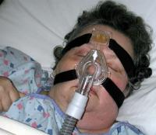
Level 2
Who is level 2 ?
Patient who needs oxygen support and close monitoring / with moderate symptoms.
Role of a nurse
Monitors vitals q2hourly
GCS assessment, saturation, mental status
Administers steroids oral dexamethasone, pantaprazole, and inj. Clexane with Doctors orders

Slide 40
Administers oxygen either low flow or high flow
Low flow oxygen – 4-6 litres of oxygen
Using nasal prongs, face mask
High flow oxygen includes venturi mask,
NIV (Helmet or face mask)
If there are signs of tachypnea, chest pain, respiratory distress, then patient is shifted to next level

Slide 41
Complete bed care is provided at bed side – bathing, toileting, hair wash and oral care, perineal care
Serves diet – assists in nasogastric tube feeding
Positions patient q2hourly
Insists patient on awake proning
Assists in ambulation if patient not on distress
Liaisons between patient with physician, health care professionals (radiographer etc)

Slide 42
Nurse administrator role in Level 2
Maintains adequate staffing
Availability of resources like PPE, Hand Rub
Ensures adherence to standard precautions
Maintains interpersonal relationship
Coordinates with health team members
Ensures infection control measures – floor cleaning, surface cleaning and wash room cleaning q4 hourly
Follows strict policies while handling deceased.
Assists and interprets investigations – ABG, chest xray

Slide 43
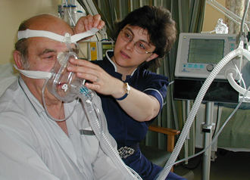
Level 3
Patients with severe symptoms requiring
ventilator support at any point of time.
Totally dependant
Continuous monitoring of vitals and other parameters.
Maintain euvolemia (Fluids)
Lab monitoring
Anticoagulants, Anti-inflammatory therapy / immunomodulatory theapy
Updates on patients condition to the loved ones (Video call)
Counseling relatives over the telephone

Slide 44
Nurse as mediator
NURSE
Doctors
Patient
Relative/ family members
Health care professionals

Slide 45
Nurses role in Step down Period
Post Covid management in the form of booklet that gives information about Nutrition, Yoga, Rest and sleep,
Helpline number / online appointment for follow up

Slide 46
Challenges in special population
Mother and child population
Person with mental illnesses, NCD,
Geriatric population
Ethical dilemmas – bed shortage, Oxygen paucity
To use the bed and oxygen for an 80 year old while a 30 year old waiting for the same?

Slide 47
Nurses Role in COVID Management – Home
Instructions for the patient
Isolation
well-ventilated room with cross ventilation and windows should be kept open
use triple layer medical mask at all times
In the event of care giver entering the room, both care giver and patient may consider using N 95 mask.
Patient must take rest and drink lot of fluids to maintain adequate hydration.
Follow respiratory etiquettes at all times.

Slide 48
Nurses role cont’d….
Frequent Hand hygiene
Don’t share personal items
Ensure cleaning of surfaces in the room that are touched often (tabletops, doorknobs, handles, etc.) with 1% hypochlorite solution.
Self-monitoring of blood oxygen saturation with a pulse oximeter is strongly advised.
The patient will self-monitor his/her health with daily temperature monitoring and report promptly if any deterioration of symptom as given below is noticed.

Slide 49
Nurses Role – Home contd.,
Psychological support and anxiety management.
Seek counselling services, when necessary (NIMHANS counselling helpline: 080-46110007)
Source: Dept. of Health and Family welfare services updated on 4-5-2021

Slide 50
Treatment: Home isolation
Symptomatic management
Warm water gargle or steam inhalation twice a day
Consider Tab Ivermectin (200 mcg/kg once a day, to be taken empty stomach) for 3 to 5 days.
Inhalational Budesonide (given via inhalers with spacer at a dose of 800 mcg twice daily for 5 to 7 days) to be given if symptoms (fever and/or cough) are persistent beyond 5 days of disease onset.

Slide 51
Do not attempt to procure or administer Remdesivir at home.
Systemic oral steroids not indicated in mild disease.
In case of falling oxygen saturation or shortness of breath, the person should require hospital admission and seek immediate consultation of their treating physician/surveillance team.

Slide 52
When to discontinue home isolation
Patient under home isolation will stand discharged and end isolation after at least 10 days have passed from onset of symptoms (or from date of sampling for asymptomatic cases) and no fever for 3 days without antipyretics and free from other symptoms.
There is no need for testing after the home isolation period is over.
Source: MoHFW 20/4/2021

Slide 53
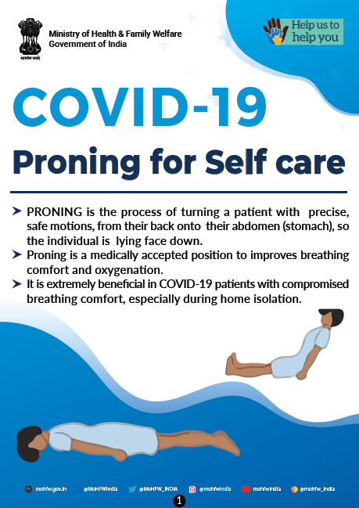

Slide 54
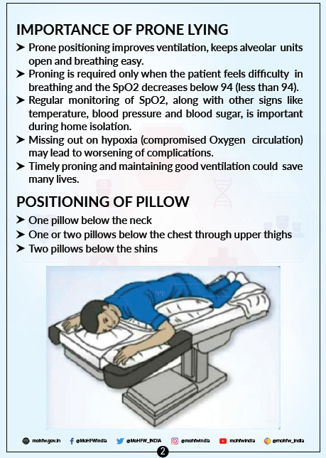

Slide 55
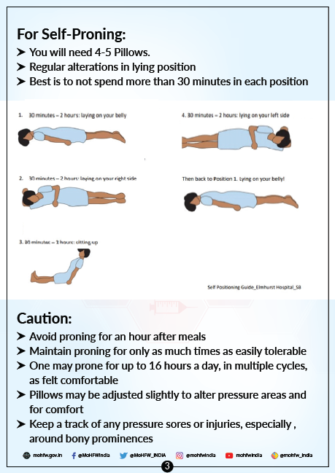

Slide 56
Avoid Proning
Pregnancy
DVT
Major cardiac condition
Unstable femur, spine or pelvic fractures

Slide 57
Nurses Role in COVID Management – Community
Compliance on Covid appropriate behaviors
Vaccination
Testing and Isolation
Creating awareness / IEC
To refer only authentic websites for information..

Slide 58
“ Let us run the race where all may win, rejoicing in their successes – as our own – and mourning their failures, wherever they are – as our own. We are all one Nurse.”
Florence Nightingale

Slide 60
OTPxpress.in/register

Slide 61
Thank you Stay Healthy Be safe

