Slide 1
INTENSIVE CARE MANAGEMENT IN COVID PATIENTS-AN UPDATE
Dr Sudheesh K
Professor
Dept of anaesthesiology
BMCRI, Bangalore
Dr Vijaykumar HN
Assoc. Professor and ICU in charge
Dept of anaesthesiology
BMCRI, Bangalore

Slide 2
Disclaimer
This lecture is regarding basic tips to manage the patient in ICU and meant primarily for novices..
Disease still is evolving and the information provided is based on current understanding of disease based on available literature.
The diagnosis and management of the patients evolve as more evidence comes to light.

Slide 3
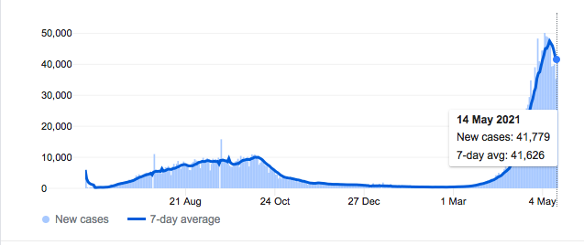
Disease burden…
INDIA
KARNATAKA

Slide 4
Disease burden…
Active caseload of Covid cases in karnataka – 600147
1.34 per cent (49,894) are with ICU support.
3.7 per cent of the patients (1,37,768) need continuous medical oxygen.
0.4 per cent (14,521) are on ventilators.

Slide 5
Introduction
Incidence of ARDS in patients presenting with COVID-19 – 42%.
Need for ICU care - 61-81%.
Wu C et al..Risk Factors Associated With Acute Respiratory Distress Syndrome and Death in Patients With Coronavirus Disease 2019 Pneumonia in Wuhan, China. JAMA Intern Med. 2020 Mar 13.
Severe COVID Illness:
Respiratory rate ≥ 30 breaths/min;
SpO ≤ 92 %;
PaO /FiO ≤ 300 mmHg .
Notes:
The respiratory
rate and SpO are two important parameters for
judging patients’ clinical condition, and allowing early
recognition of ARDS.

Slide 6
Need for ICU care
Tachypnea (respiratory rate > 24 per minute),
Tachycardia (HR >120/ min)
Hypotension (SBP < 90 mm of Hg)
PaO2 <50 mm Hg on room air or SpO2 <90% on supplemental oxygen of 6 Lpm.

Slide 7
Need for ICU care
Confusion.
Leukopenia and Thrombocytopenia.
Uremia
Multilobar infiltrates.
Hypotension requiring fluid resuscitation.
Hypothermia.
Quick sequential organ failure assessment (qSOFA) > 2.

Slide 8
Personnel and responsibilities
Doctors – perform procedures, follow patients, communicate with in charge and modify management. Ensure follow up of protocols
Nurses – indent and maintenance of drugs and equipments, drawing blood..etc
Group D – setting bed, cleaning of premises, disposal of waste, delivery of food to patients.
Role of radiologist – x ray, USG CT Scan..minimize patient movement.
Duty shifts – 6 hrs with full PPE.
Fogging, dehydration..

Slide 9
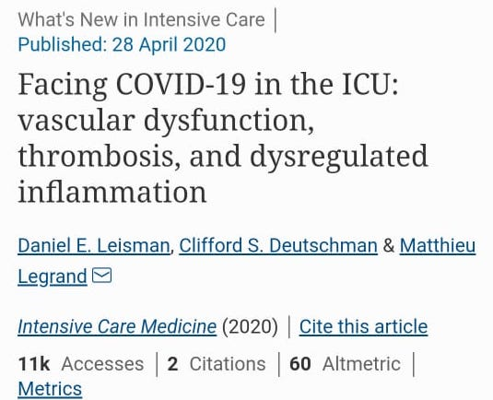
Pathophysiology relevant to ICU management
Initial reports –
binding of virus to respiratory epithelium and penetration
Macrophage infiltration , exudation and alveolar damage.
Present evidence –
New evidence based on autopsies of deceased patients
Lung damage due to extensive pulmonary thrombosis
Virus attack on beta chain of heme and blockade of oxygen binding
Leisman et al. Intensive care 2020

Slide 10
Coagulation and COVID 19
Fibrinogen and D-dimer – increased
Prothrombin time (PT) and activated partial thromboplastin time (aPTT) – modest prolongation
Mild thrombocytosis or thrombocytopenia.
The presence of a lupus anticoagulant (LA) is common in individuals with a prolonged aPTT.
Risk of venous thromboembolism – 25%-43%
Notes:
Fibrinogen and D-dimer are increased, with typically only modest prolongation of the prothrombin time (PT) and activated partial thromboplastin time (aPTT) and mild thrombocytosis or thrombocytopenia. The presence of a lupus anticoagulant (LA) is common in individuals with a prolonged aPTT.
The risk for venous thromboembolism (VTE) is markedly increased, especially in patients in the intensive care unit (ICU), with case series reporting prevalences of 25 to 43 percent in ICU patients, often despite prophylactic-dose anticoagulation.

Slide 11
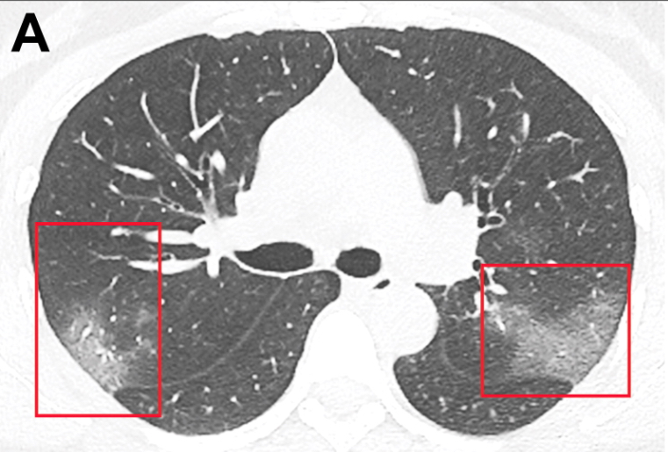
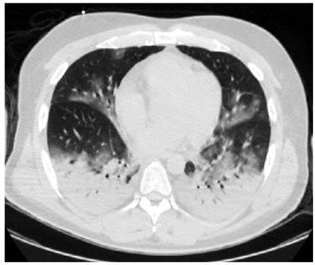
Low lung weight vs High lung weight
Type L | Type H
Low elastance | High elastance
Low V/Q ratio | High right-to-left shunt
Low lung weight | High lung weight
Low lung recruitability | High lung recruitability
Various non invasive modes | Non invasive modes less effective
Low PEEP high tidal volume strategy | High PEEP, lung protective strategy
John J. Marini, MD et al
JAMA. Published online April 24, 2020. doi:10.1001/jama.2020.6825

Slide 12
New insights….
The key issue in this early stage - disrupted vasoregulation, (failure of hypoxic pulmonary vasoconstriction)
Supportive non invasive measures for oxygenation may help…
However, worsening of disease due to infection/ Cytokine storm
Persistent strong spontaneous inspiratory efforts –
tissue stresses
pulmonary transvascular pressures, vascular flows, and fluid leakage ( Self inflicted lung injury P-SILI).
Notes:
The key issue in this early stage is disrupted vasoregulation, where the pulmonary
vasoconstriction that normally occurs in response to hypoxia fails to occur because
of an endothelial assault that mismatches perfusion to ventilation and may
result in profound hypoxemia. The clinician’s first response, boosting FIO2, may indeed
prove effective early on. If insufficient, noninvasive support (eg, high-flow
nasal O2, CPAP, Bi-PAP) may stabilize the clinical course in mild cases, provided
that the patient does not exert excessive inspiratory efforts. However, if respiratory
drive is not reduced by oxygen administration and noninvasive support, persistently
strong spontaneous inspiratory efforts simultaneously increase tissue
stresses and raise pulmonary transvascular pressures, vascular flows, and fluid
leakage (ie, P-SILI).8-10 Progressive deterioration of lung function (a VILI vortex)
may then rapidly ensue.

Slide 13
Respiratory care
Oxygen supplemenation
Low flow oxygen
High flow oxygen
Non invasive ventilation
Invasive ventilation
ECMO

Slide 14
Oxygenation targets
SpO₂ – 92% - 94%
PaO2 – 55 mm of Hg and above
Lower limits in case of pre existing pulmonary disorders and old age
Presence of respiratory alkalosis in ABG – increased work of breathing

Slide 15
Oxygen therapy
Low flow oxygen
Supplemental oxygenation with a low flow system via nasal cannula (ie, up to 4 L/min).
Simple face mask (upto 6 lts/min)
Venturi face mask, or non rebreather mask.
High oxygen requirement
High flow nasal oxygen (HFNO)/ Non invasive ventilation

Slide 16
High flow nasal oxygen therapy
Emerging evidence – beneficial in patients with mild to moderate ARDS in controlled conditions.
May delay intubation.
Early intubation - greater workload on ICU personnel and greater morbidity.
Risk of spread of infection to HCP – main concern
Lack of evidence to decisively prove the diminished need for invasive ventilation.

Slide 17
High flow nasal oxygen therapy
Experimental observations – aerosol spread upto 200 mm from the patients nares with flows of 60 lts/ min. and upto 300 mm with CPAP
Ensure proper positioning of nasal cannula,
Proper connections with emphasis on use of humidifiers
Flows as minimum as possible ( 40 lts/ min)
Change over to next level if distress persists at flow of >40 lts/min and FiO2 > 60%

Slide 19
Early Awake proning with HFNC
Case series of 10 patients – PaO2/FiO2 ratio < 300
Xu, Q., Wang, T., Qin, X. et al. Early awake prone position combined with high-flow nasal oxygen therapy in severe COVID-19: a case series. Crit Care 24, 250 (2020). https://doi.org/10.1186/s13054-020-02991-7

Slide 20
Awake proning and intubation

Slide 21
5 out of 24 required intubation- 4 of them had prone for less than one hour

Slide 22
HFNC v/s NIV
Better to use HFNC over NIV. (initial thoughts)
Based on respiratory mechanics…
Those presenting with happy hypoxia – HFNC
Those with tachypnoea, respiratory dyssynchrony and increased work of breathing – Non invasive ventilation..

Slide 23
NIV initiation…
Modes: CPAP/ BiPAP
PEEP – adjusted to ensure saturaton above 90%
Inspiratory pressure/ pressure support - adjusted to attain tidal volume sufficinet enough to avoid CO2 retention.

Slide 24
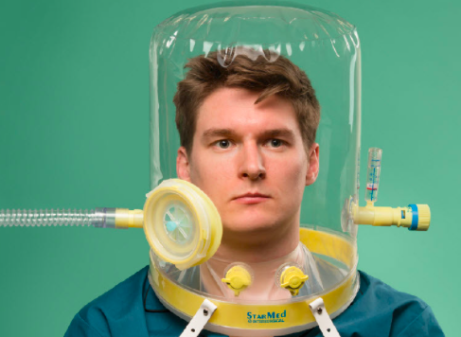
NIV in COVID 19
Evidence emerging in favour of NIV in selected patients.
Preferable to have a full face mask rather than oronasal or nasal mask.
CPAP/BiPAP only with ICU ventilators which has individual inspratory and expiratory limb. (Viral filter attached to expiratory limb)
Use of CPAP hood – to prevent aerosol spread – Loss of PEEP of 4 – 5 cm of H2O

Slide 25
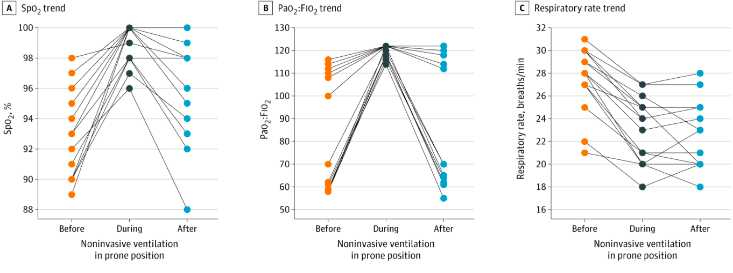
NIV with proning
Mild to moderate ARDS
Notes:
Proning improved parameters and only one

Slide 26
When to intubate
Tachypnea (respiratory rate > 30 per minute)
Poor oxygenation (Pao2 to Fio2 ratio less than 150 mmHg)
SpO₂ - < 92%. (SpO2/ FiO2 ratio < 315)
Tachycardia (HR >120/ min)
Hypotension (SBP < 90 mm of Hg)
After 2-h high- flow oxygen therapy or noninvasive ventilation.
LOW GCS (less than 7), even if oxygenation is acceptable

Slide 27
Technique of intubation
Problems:
Poor respiratory reserve
Lack of time for airway assessment
Movement and vision restriction due to protective gear.
Psychological pressure
Mandatory to strictly follow the personal protective equipment donning process for high-risk exposure.

Slide 28
Prerequisites
Personnel performing intubation and ventilation at higher risk of contracting the infection.
Thorough preparation
Satisfactory preoxygenation
Modified rapid sequence induction
Rapid intubation using a video laryngoscope

Slide 29
Preparation…
Components | Action
Oxygen | Ensure an adequate supply of oxygen is available
Helpers | Identify and ensure helpers are readily available
M: Monitor | Ensure pulse oximetry, electrocardiography, and noninvasive blood pressure monitors are functional
S: Suction | Ensure suction is functional and readily available

Slide 30
Preparation…
Components | Action
M: Machine | Anesthesia machine, ICU ventilator, High flow nasal oxygen is functional and ready to go
A: Airway supplies | Ensure the video laryngoscope (e.g., GlideScope) is functional and have a direct laryngoscope as a backup Flush and ensure functional
I: Intravenous access and Drugs | intravenous access Have all drugs for sedation, anesthesia induction and muscle relaxation and different vasoactive drugs prepared

Slide 31
Intubation
Preoxygenation. (CPAP method or high flow oxygen with mask)
Use of HME filters
Medications:
Midazolam 1-2 mg IV
Propofol 1 – 1.5mg/ kg if no hypotension
Etomidate 0.3 mg/ kg/ Ketamine 1.5 mg/ kg if there is hypotension
Succinylcholine 1 – 1.5 mg/ kg or Rocuronium 0.9 mg/ kg for facilitating intubation.
Lignocaine preservative free (Xylocard) 1 – 1.5 mg/ kg to prevent pressor response to intubation.

Slide 32
Intubation
Intubation as an elective procedure
Drugs kept prepared before hand in a separate area
Combine intubation as bundle with other procedures (viz.. Arterial line, central line..etc) in a negative pressure procedure room
Minimize movements

Slide 33
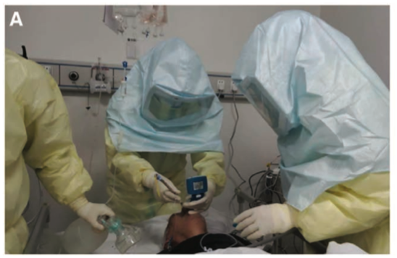
Intubation…
Intubation using direct laryngoscope or video laryngoscope.
Video laryngoscope – greater distance between patient and doctor and also higher success rates

Slide 34
Basic respiratory care
Patient with respiratory symptoms
O2 supplementation by face mask 6 lts/ min
High flow nasal oxygen
Intubation and invasive ventilation

Slide 35
Invasive ventilation
Ventilator management – lung protective strategy
VT 4-8ml/kg
Respiratory rate upto 35 to maintain MV (6-8 lts/ min)
pPeak - < 35 cm of H₂O
pPlat - <30 cm of H₂O,
PEEP – High (10-15 mm of Hg) vs Low (5-10 mm of Hg)
FiO2 – to maintain SpO₂ – 94-96%.

Slide 36
Invasive ventilation
Initial tidal volume calculation: 6 X Pred. body weight (PBW)
PBW (Males): 50+2.3 (height in inches – 60)
PBW (Females): 45.5 + 2.3 (height in inches – 60)
Target: SpO2 – 88% – 94%
Subsequent VT adjustment:
Check pPlat every 4 hrs (by doing inspiratory hold for 0.5 sec)
If pPlat > 30 cm of H2O – decrease Vt by 1 ml/ kg (minimum 4 ml/ kg)
High tidal volume (7-8 ml/kg) with low PEEP (,10 cm of H2O)???? for type L

Slide 37
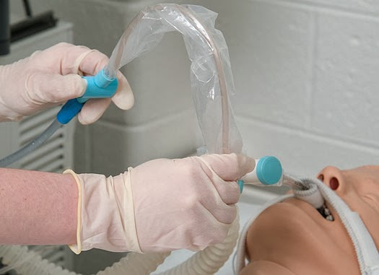
Invasive ventilation
Care:
Regular suctioning – in line endotracheal suctioning
Avoid use of nebulizers – MDI preferred
Alveolar recruitment manuevers –
Single breath hold for 30 sec followed ventilation prefered over stacked breath holding.
Monitoring of airway pressures and flow volume loops to detect tube blockade, ET migration…

Slide 38
Prone ventilation
Early prone ventilation has shown benefit in these patients
Alveolar recruitment
Pulmonary blood flow redistribution resulting in bettter V/Q matching.
Proning even during non invasive ventilation has been suggested.
Duration of proning - as long as tolerated (upto 12 -16 hrs)
Ensure all connections are intact during proning (preferably done during shift change)

Slide 39
Prone ventilation
Contraindiactions:
Shock (MAP < 65 mm of Hg), acute hemorrhage
Pregnancy
Airway surgery within 2 weeks
Spine instability
Trauma
Raised Intracanial pressure
History/ presence of DVT

Slide 40
Prone ventilation
Complications:
Nerve compression (eg, brachial plexus injury)
Crush injury
Venous stasis (eg, facial edema)
Dislodging endotracheal tube
Diaphragm limitation
Pressure sores (eg, facial)
Dislodging vascular catheters or drainage tubes
Retinal damage
Transient reduction in arterial oxygen saturation, arrhythmias
Vomiting
Venovenous ECMO when all methods of ventilation fails

Slide 41
Ventilator monitoring…
Peak airway pressure
Plateau airway pressure
Fio2 delivered
Compliance
pPeak
Obstruction to flow, tube kinking/ endobronchial migration
Bronchospasm
pPeak + pPlateau
Worsening of disease
Pulmonary edema
Superadded infection
pneumothorax

Slide 42
Lung USG in Covid 19
B lines – storm of clusters, lines extending upto lower end of screen with intermittent on off pattern. (waterfall effect)

Slide 43
Cytokine storm (sHLH syndrome)

Slide 44
Treatment protocol
Steroids – Low dose,
Low molecular weight heparin
Antibiotics
Supportive measures
Specific therapy:
Remdesvir
Monoclonal antibodies/JAK inhibitors

Slide 45
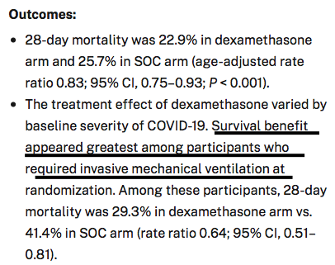
Treatment protocol
Dexamethasone 6 mg OD for ten days or till discharge whichever is earlier
The total daily dose equivalencies to dexamethasone 6 mg (oral or intravenous [IV])²¹ are:
Prednisone 40 mg
Methylprednisolone 32 mg
Hydrocortisone 160 mg
STEROIDS – MAINSTAY….

Slide 46
Treatment protocol…
Low molecular weight heparin vs unfractionated heparin
D Dimer as guide for dosage.....
< 1000 ng/ml (wt < 100 Kg) – enoxparin 40 mg OD
<1000 ng/ ml (wt 100-150 kg) enoxparing 40 BD
<1000 ng/ ml (wt >150 kg) – enoxparin 60 mg BD
1000-3000 – 40 – 120 mg BD based on weight
>3000 ng/ ml – tinzaparin 175 Units/ kg OD
UFH – 5000 U 8th hrly for prophylaxis,

Slide 47
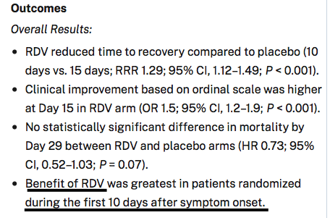
Remdesvir
No observed difference in time to recovery between arms in patients on high-flow oxygen or noninvasive ventilation at enrollment
No mortality or recovery benefit in mechanically ventilated patients

Slide 48
Treatment protocol…
2022 patients in trial arm, 2094 in control arm
28 day mortality – 596 (29%) in trial arm vs 694(33%) in control arm

Slide 49
Criteria to be fulfilled for Tocilizumab
Escalating need of oxygen requirement.
Patient is on HFNO, flow rate greater than 30lts/min to maintain SpO2 > 90%/ NIV with FiO2 > 60%/ Intubated and ventilated.
Patient is having hypotension needing vasopressors to maintain BP.
Patient has received steroids for > 48hrs.
C-RP level > 75mg/L
ROX index 2.85-3.84. ROX index = SpO2/FiO2
Respiratory Rate

Slide 50
ICU care
Hemodynamic management – crystalloids. (RT feeds in intubated patients unless contraindicated) AVOID COLLOIDS/ ALBUMIN
Based on dynamic indices such as IVC filling, pleth variability index with Passive leg raising test.
Positive balance for first few days followed by maintenance of net balance
Noradrenaline – vasopressor of choice (MAP target > 65 mm of Hg)
Adrenaline or vasopressin if noradrenaline not sufficient
Dobutamine if proven cardiac dysfunction
ABG, lactate, electrolytes assessment to guide fluid management.
Target Hb% - 7 gm% in normal and 8 gm% in presence of co morbidities.
Target Blood glucose level - < 180 mg%

Slide 51
ICU care
Nutritional management to ensure adequate supply of proteins and micronutrients – zinc beneficial effect.
Sedation – Fentanyl/ Midazolam as per requirement
Neuromuscular blocking agents – only if there is deterioration due to ventilator patient dyssynchrony
Antibiotics as per standard protocols and cultures

Slide 52
ICU care
Bedside ECHO and lung USG – cardiac performance (myocarditis), monitoring lung expansion.
Renal replacement therapy – as patients can go for acute kidney injury.

Slide 53
ICU care
Bedside ECHO and lung USG – cardiac performance (myocarditis), monitoring lung expansion.
Regular monitoring of renal function – urine output, RFT, electrolytes
Renal replacement therapy – as patients can go for acute kidney injury.
Extended dialysis found to be beneficial

Slide 54
Logistics and support
Communication – internal and external
Within the teams – to ensure clear transfer of information at critical times - SBAR
S- situation assessment
B- background of the problem
A – assessment of patient
R –response expected

Slide 55
Logistics and support
With family and patients – to ensure clear transfer of information at critical times - SPIKES
S- setting up the interview
P–assessing the patient’s perception of the problem and patient’s condition
I–obtaining the invitation to initiate the discussion
K–giving knowledge and information
E–addressing the emotions
S–strategy and summary

Slide 56
What matters…..
A dedicated and committed nursing care and basic management goes a long way in improving the outcomes…

Slide 57
THANK YOU FOR YOUR PATIENT HEARING

